Slide 1
PERIPARTUM CARDIOMYOPATHY
DR JASSIM KP
SENIOR RESIDENT
DEPARTMENT OF CARDIOLOGY

Slide 3
References
Fuster and Hurst’s the Heart- 15th edition
Braunwald’s Heart Disease- 12th edition
Peripartum Cardiomyopathy: JACC State-of-the-Art Review 2020
Peripartum cardiomyopathy : AHA CIRCULATION 2016

Slide 6
“An idiopathic cardiomyopathy presenting with HF secondary to LV systolic dysfunction towards the end of pregnancy or in the months following delivery, where no other cause of heart failure is found”
LVEF< 45%
May or may not have ventricular dilation

Slide 7
Incidence
United States 1:3,000–4,000 -Pearson et al
Nigeria 1%- Sanderson et al
South Africa 0.1%- Sliwa et al
Japan 1 in 20,000 - kamiya et al
India - 1 in 1541 Aditya John et al
1 in 1374 Pandit et al

Slide 8
Age - >50% cases - >30 years of age
Race - >40% of cases - black women
younger age
higher prevalence of hypertension
lower rate of recovery of LV EF.

Slide 9
Preeclampsia and Hypertension-
Meta-analysis of 22 studies
Preeclampsia - 22%
Hypertensive disorder- 37%
Multiple Gestations-

Slide 10
Substance abuse
Anemia
Asthma
Prolonged tocolysis
Diabetes mellitus
Obesity
Malnutrition

Slide 11
Pathophysiology
Vasculo – hormonal hypothesis

Slide 12
Mouse model –
Absent of cardiomyocyte STAT 3 activity→ activation of cathepsin D
16kDa prolactin - promotes expression of miRNA 146a→ endothelial dysfunction

Slide 13
PGC-1α -peroxisome proliferator-activated receptor γ coactivator 1 alpha→ transcriptional regulator
Expression of VEGF
Expression of MnSOD
Deletion of PGC-1α → vasculotoxicity

Slide 14
Placental angiogenic factors
During late gestation , placenta secretes soluble Fms- like tyrosine kinase 1 (sFlt1)- anti angiogenic protein
Sequesters VEGF , placental growth factor
Anti angiogenic and pro inflammatory
Markedly elevated in pre-eclampsia and twin gestation

Slide 15
Genetics

Slide 16
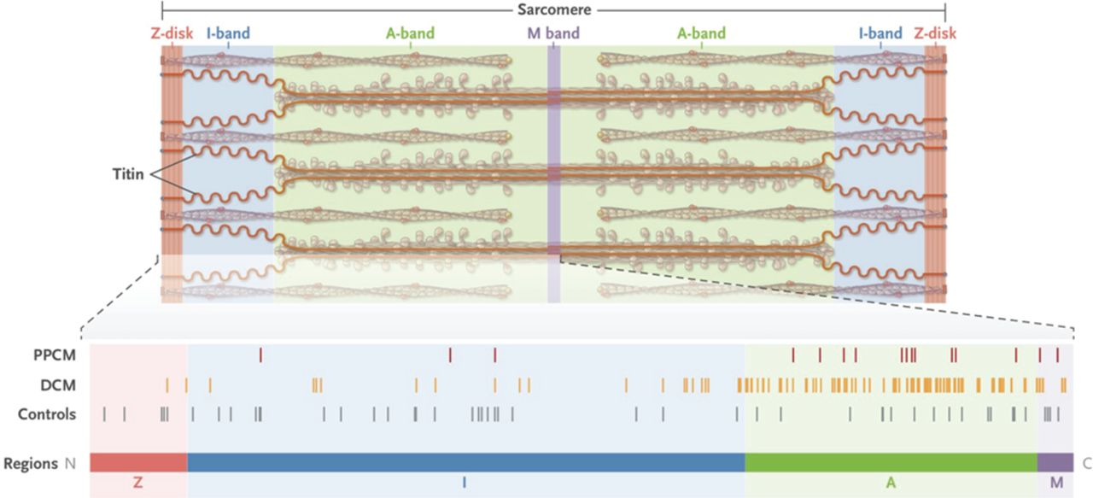
Sequenced 43 genes associated with DCM in 172 women with PPCM
26 truncating variants – 65% in TTN gene

Slide 17
Presence of TTN variant predicted lower LVEF at 12 months
TTN mutants seen in 13% black women compared to 8% white , which could explain higher incidence and worse prognosis.

Slide 18
Genetic study of 469 women with PPCM- 10 % prevalence of truncating variants in TTN
Truncating variants in
FLNC
DCP
BAG 3
profile very similar to that found in DCM

Slide 19
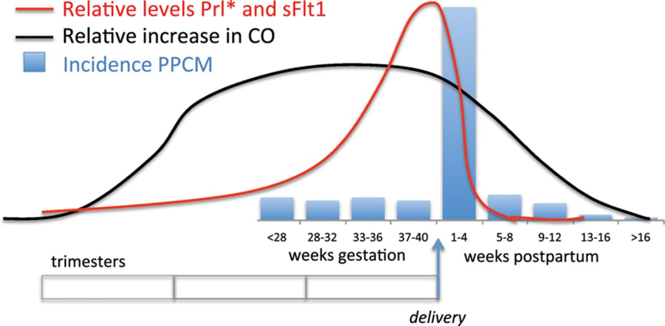
Clinical presentation
Majority cases occur in week after delivery
Subset – 2nd and 3rd trimester , or later than 1 month post partum

Slide 20
Signs and symptoms of normal pregnancy can mimic those of HF – leads to missed or delayed diagnosis of PPCM

Slide 21
Tachypnea
Tachycardia
Raised jvp
Peripheral edema
Displaced apical impulse
3rd heart sound
Murmurs of mitral and tricuspid regurgitation
Pulmonary rales

Slide 22
ECG-
Most common-
sinus tachycardia
T wave flattening
non specific ST segment depression
LA enlargement , LVH ,LBBB may be present

Slide 24
ECHO
Variable degrees of LV dilation
LVEF is typically<45%
Right ventricular and biatrial enlargement
Mitral and tricuspid regurgitation
Pulmonary hypertension

Slide 25
Cardiac MRI- provides accurate ejection fraction and chamber measurements when the echocardiogram is inadequate
BNP levels markedly elevated

Slide 26
PROGNOSIS AND OUTCOMES

Slide 27
ADVERSE OUTCOMES.
In a study of 182women with PPCM, the major adverse event preceded the diagnosis of PPCM in one-half of the patients
( sorel et al . 2009)
Cerebrovascular events and cardiopulmonary arrest were associated with residual brain damage
LV thrombus - 10% to 17%
Thromboembolic complications -5% to 9%
Mechanical circulatory support
Cardiac transplantation
Death

Slide 28
Prognostic factors
LVEF at the time of diagnosis -most reliable predictor of adverse events or long-term recovery
LVEF<30% - lower rates of recovery and increased risk of adverse events
LV dilatation
LV thrombus
RV systolic dysfunction
obesity

Slide 29
African-American ethnicity - strongly associated with lower rates of recovery
Longer recovery time→ more adverse outcomes
higher mortality
Concomitant pre-eclampsia -lower 1-year survival
but higher rates of LV recovery in survivors
Biomarkers
Troponin
NT-proBNP
sFlt1
C-MRI -Late gadolinium enhancement –indicate fibrosis → less myocardial recovery
GNB3 TT genotype- less myocardial recovery at 1 year

Slide 30
RECOVERY
Higher rate of recovery than other forms of HFrEF
Usually first 3 to 6 months
Delayed recovery –can also occur - even up to 2 years

Slide 32
management

Slide 33
Goals
To improve symptoms of heart failure
To achieve recovery of cardiac function
To prevent thromboembolic complications
To prevent sudden arrhythmic death
Treatment of HF during pregnancy requires special modifications to ensure fetal safety

Slide 35
Anticoagulation
should be considered - severely decreased LVEF during late pregnancy and 6 to 8 weeks postpartum
AHA- LVEF <30%
ESC- LVEF <35%

Slide 36
Bromocriptine
Dopamine agonist
Inhibits the release of prolactin
Benefit – shown in 2 small human studies in Africa
Inconclusive- in a small randomized German study
The 2018 European Society of Cardiology -Class IIb, Level of Evidence: B

Slide 37
Therapeutic anticoagulation is recommended in conjunction with bromocriptine
Decrease milk production

Slide 38
Treatment of Severe PPCM.
IV vasodilators-nitroglycerin- acute decompensated HF
Nitroprusside - less desirable-risk of cyanide toxicity
Dobutamine -observational study of 27 non-randomized patients with PPCM and LVEF<25%
7 women treated with dobutamine had worse outcomes
Levosimendan is an alternative inotrope –but was not shown to improve outcomes in a randomized study of 24 patients with PPCM
A recent comparison of milrinone and levosimendan in 15 patients showed comparable hemodynamic improvement with both drugs

Slide 39
Implantable Cardioverter- Defebrillator
30% mortality of PPCM – sudden cardiac death
Mostly- within first 6 months and LVEF < 30%
AHA (2016)-
As recovery usually occurs in 6 months- reasonable to use wearable external defebrillator in severe LV dysfunction
Permanent ICD – if no recovery (level of evidence-B)
LBBB and persistent LVEF <35%- CRTD recommended

Slide 40
Advanced therapies
60% of cardiogenic shock during or shortly after pregnancy- PPCM
Temporary mechanical circulatory support - in hemodynamically instable- despite inotrope
intra-aortic balloon pump
percutaneous ventricular assist device therapy
extracorporeal membrane oxygenation
A study of 485 women with PPCM who received cardiac transplant between 1987 and 2010 reported higher rates of graft failure and lower age-adjusted survival, which may be explained by increased rejection, higher allo-sensitization

Slide 41
Labor and Delivery
An attempt to stabilize the mother to avoid potential fetal complications of prematurity is reasonable.
Hemodynamic instability despite medical therapy should prompt early delivery or termination
Stable patients are delivered vaginally unless there are obstetric reasons for cesarean section
Cesarean delivery is associated with a higher incidence of hemorrhage, infection, and thromboembolic complications

Slide 42
The post-partum risk of fluid overload and pulmonary edema must be anticipated
Following delivery, removal of caval compression by the fetus, autotransfusion due to uterine contractions, and fluid mobilization and resorption contribute to an increase in venous return.

Slide 43
Duration of Treatment
Persistent cardiac dysfunction- medications-indefinitely.
After LV recovery-optimal duration of treatment is unknown.
If congestive symptoms-diuretic can be stopped.
Additional HF medications, if stopped, should be weaned in a stepwise fashion with frequent clinical assessment and echocardiographic monitoring of LVEF (i.e., every3 to 6 months).
Reassessment of LV function is advised after drug discontinuation followed by annual clinical and echocardiographic assessment.

Slide 44
Subsequent pregnancy
Risk of relapse
ESC- 2018- discourages subsequent pregnancy when EF not recovered to > 50-55%
Mortality- in persistent LV dysfunction- 1 out of 6

Slide 48
Conclusion
The diagnosis of PPCM should be considered in any pregnant or postpartum woman with symptoms concerning for HF.
An elevated BNP level should always be followed by an echocardiogram to assess for systolic dysfunction.
Prompt treatment with medications tailored for pregnancy and lactation may prevent adverse outcomes.
Limited studies suggest breastfeeding is safe.

Slide 49
Acutely ill women should be managed by specialized multidisciplinary teams, and may require advanced HF therapies.
Women considering a subsequent pregnancy should be counseled and monitored by physicians familiar with PPCM.
Long-term follow-up is important.

Slide 50
Thank you

